Slide 1

IDA Project New Year Resolutions Bucharest Academy of Economic Studies Applied Statistics and Data Science Master 2022
Dorobantu Diana

Slide 2
I. Objectives
categorizing emotions from tweets regarding New Year Resolutions
finding insights about people’s motivations & goals
explore people’s way of thinking
learn & having fun

Slide 3
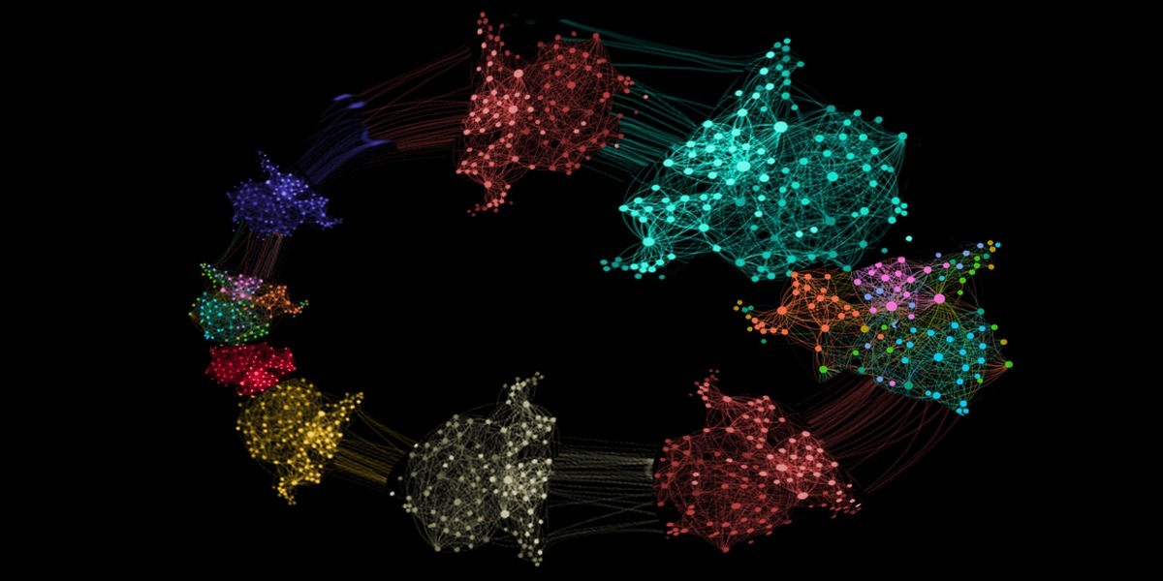
II. Methodology
Sentiment Analysis
use of natural language processing, text analysis, computational linguistics and biometrics to systematically identify, extract, quatify and study
affective states & subjective information
CRISP
&
Clusterization

Slide 4
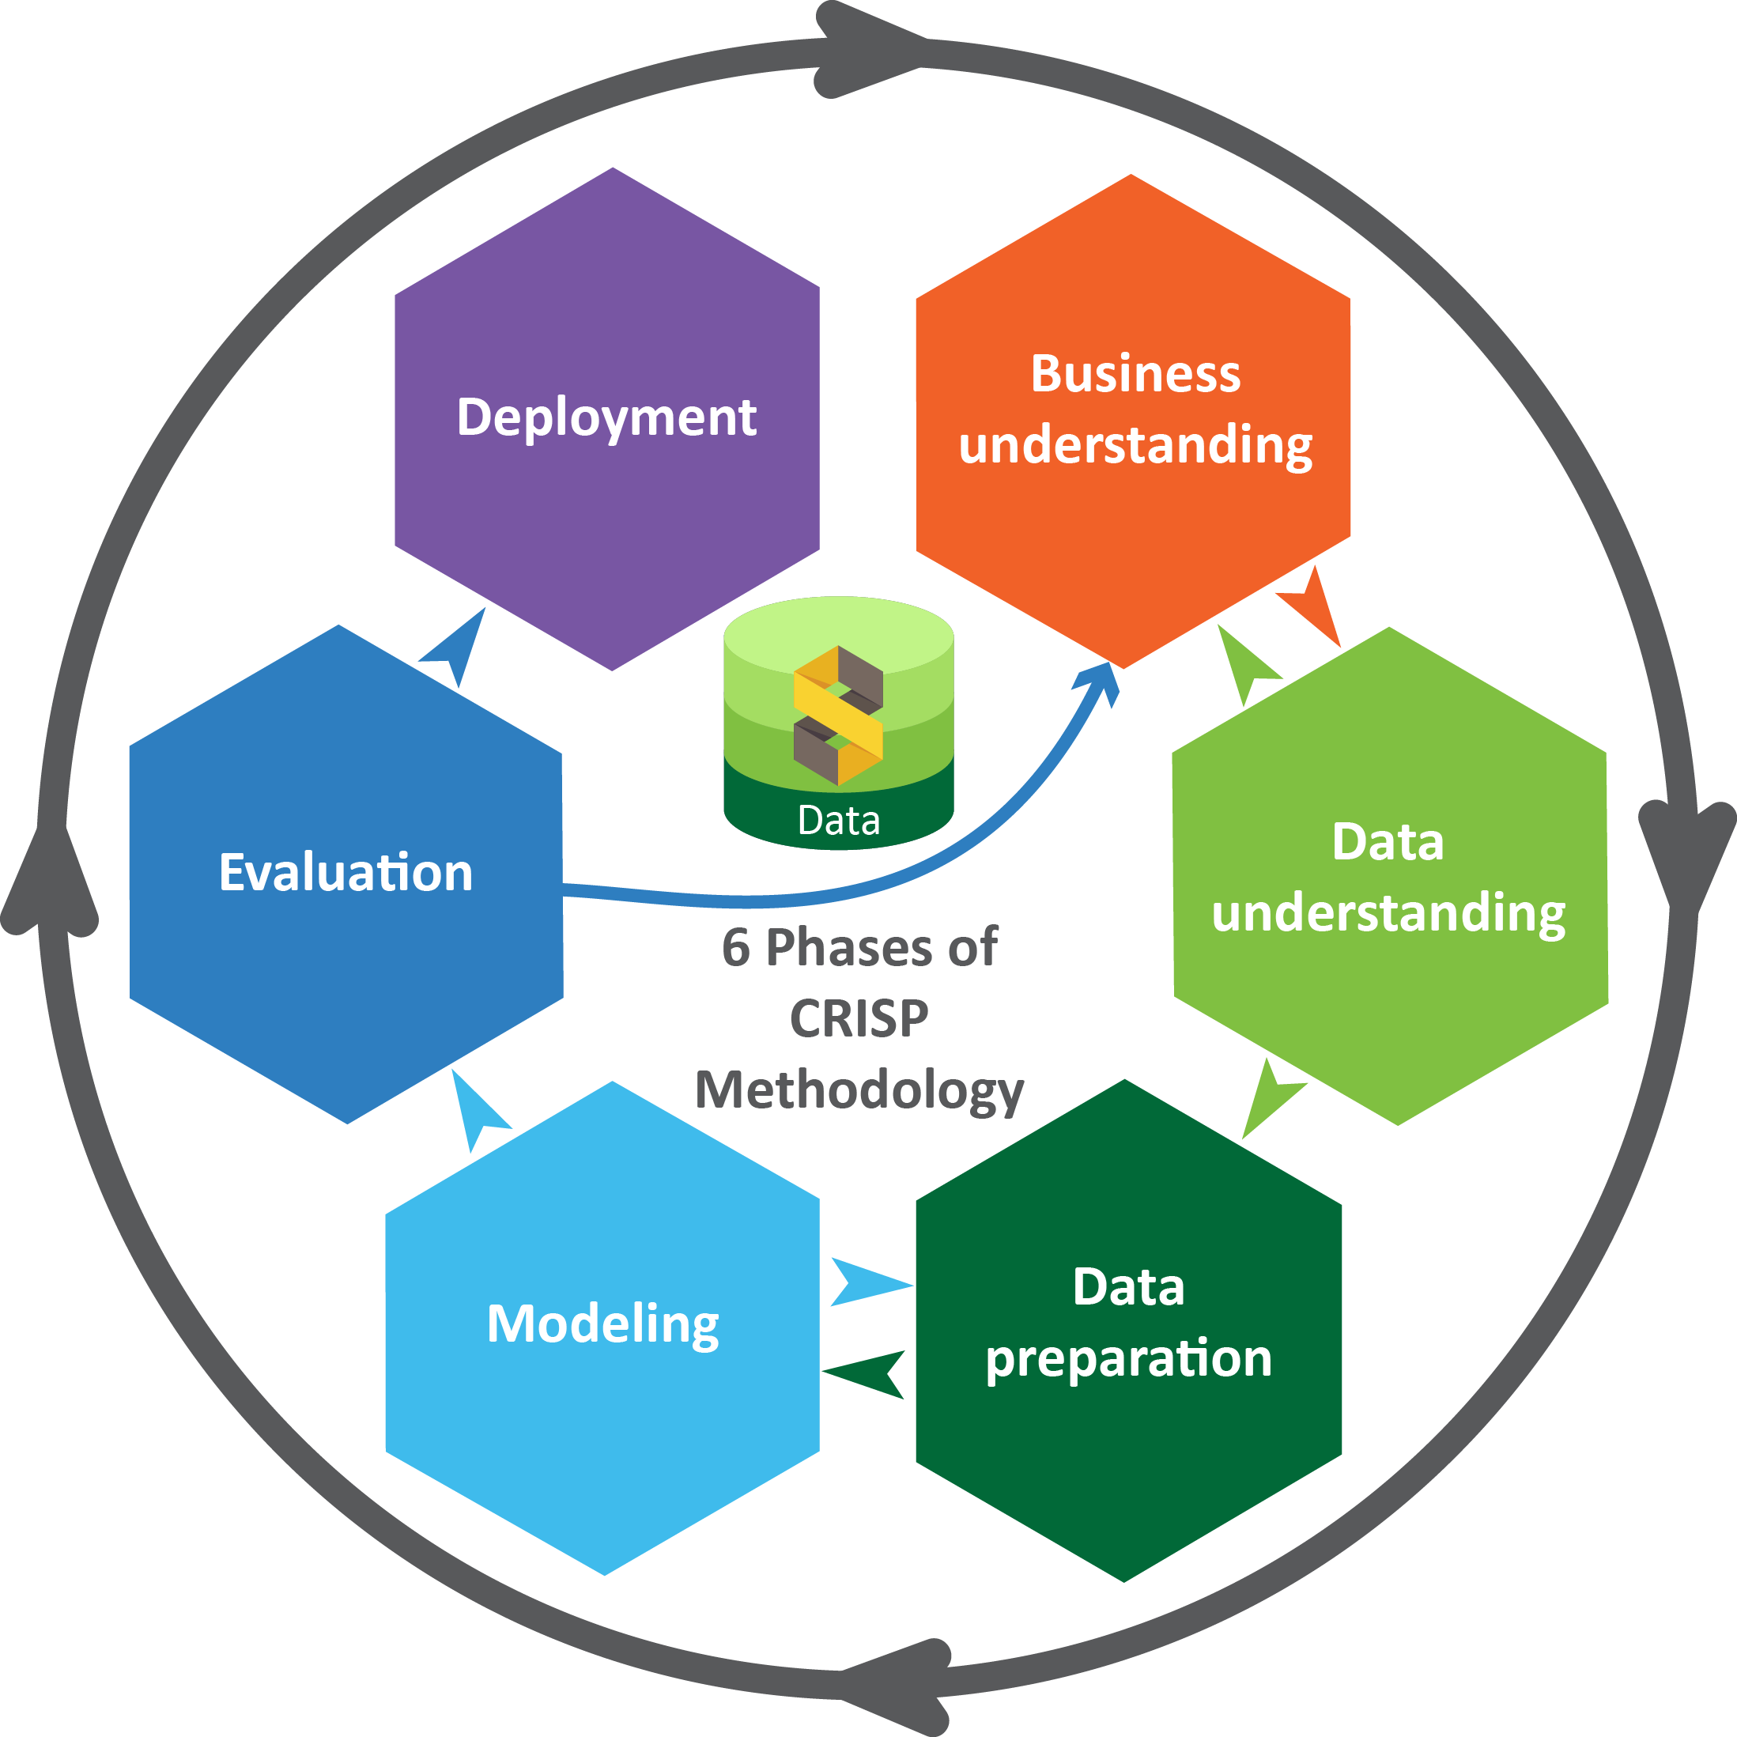


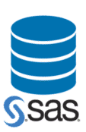

III. Process
DB

Slide 5
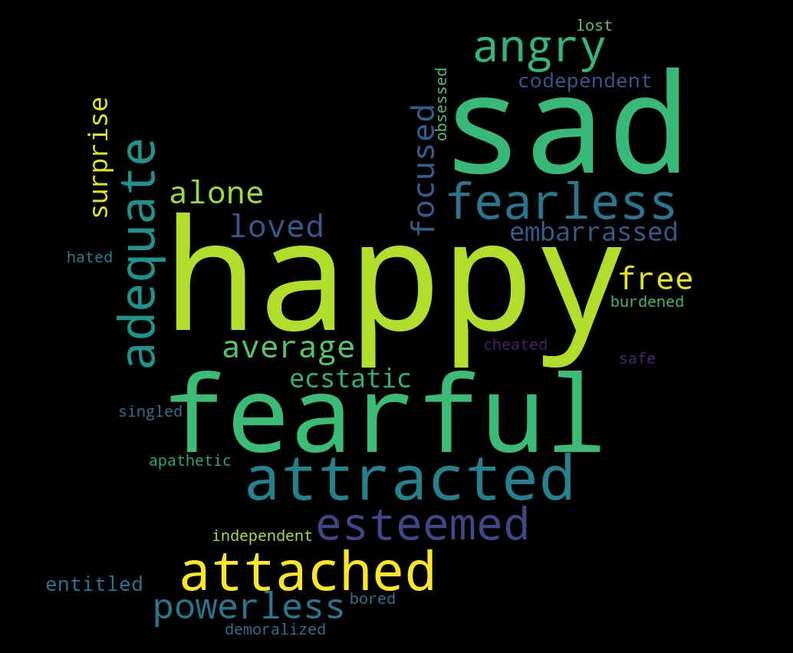
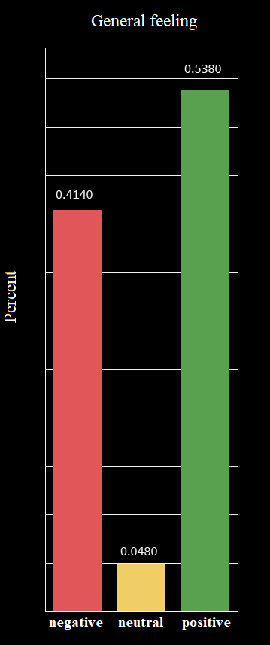
IV. Results
V. Conclusions

Slide 6

V. Tools

Slide 7

Thank you!

Slide 8
